Slide 1
COMP3851A
Freshman
Orientation
Website
LearnLink Website
Student Resources
Clubs & Events
Services
About Singapore
Group 2: LearnLink

Slide 2
ABOUT US
LearnLink Website
Student Resources
Clubs & Events
Services
About Singapore
We are, LearnLink, creates a user-friendly app for freshmen at the University of Newcastle, consolidating all essential information and resources into one accessible platform.

Slide 3
Tajbir Singh Bal (Project Manager) c3434693
Jason Eng (Deputy Project Manager) c3426445
Mai Huy Nam (Database Designer) c3435372
Arthhur Yu Hong Lee (Back-End Developer) c3412857
Sudhan (Front-End Developer) c3435375
Ingyin Phyo (Technical Writer) c3420347
LearnLink Website
Student Resources
Clubs & Events
Services
About Singapore

Slide 4
Development Process
Project Aims
Addressing Freshman Needs
Software Demo
Key Features of the Website
Collaboration and Commitment
LearnLink Website
Student Resources
Clubs & Events
Services
About Singapore
01
02
03
04
05
06

Slide 5
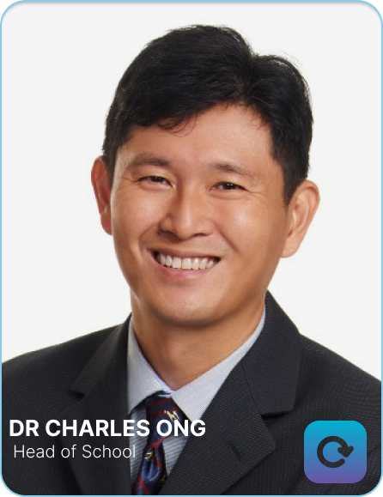
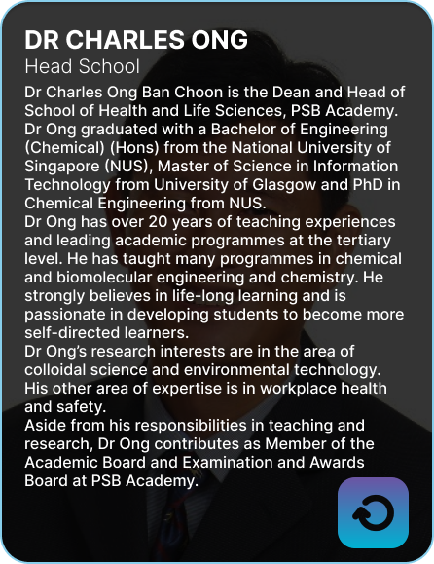
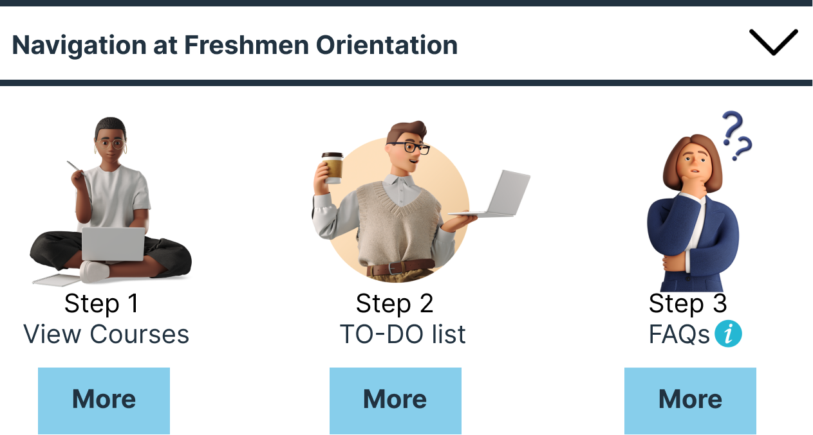
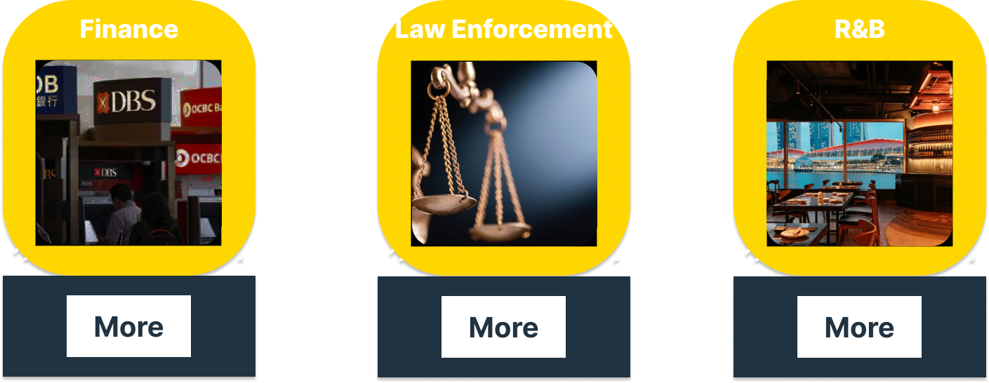
Project Aim
Step-by-step Guide
Intuitive Navigation
Interactive Elements
LearnLink Website
Student Resources
Clubs & Events
Services
About Singapore
A comprehensive guide navigates students through orientation essentials.
LearnLink's orientation website prioritizes first-year students, offering straightforward navigation.
The website's testimonials provide authentic experiences, enriching the orientation process.
Notes:
1A comprehensive guide navigates students through orientation essentials, including course selection, to-do lists, and FAQs, preventing overload.

Slide 6
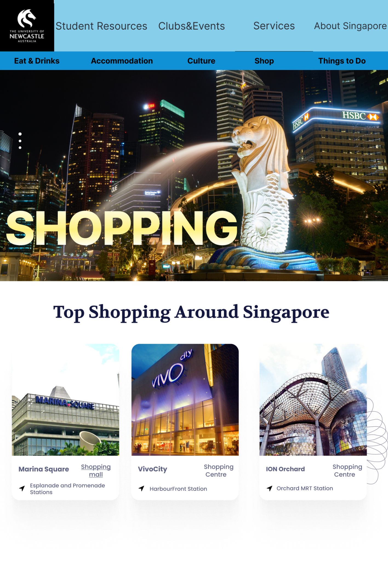
User-Friendly
Design a freshmen-focused, engaging interface for seamless navigation and increased engagement.

Slide 7
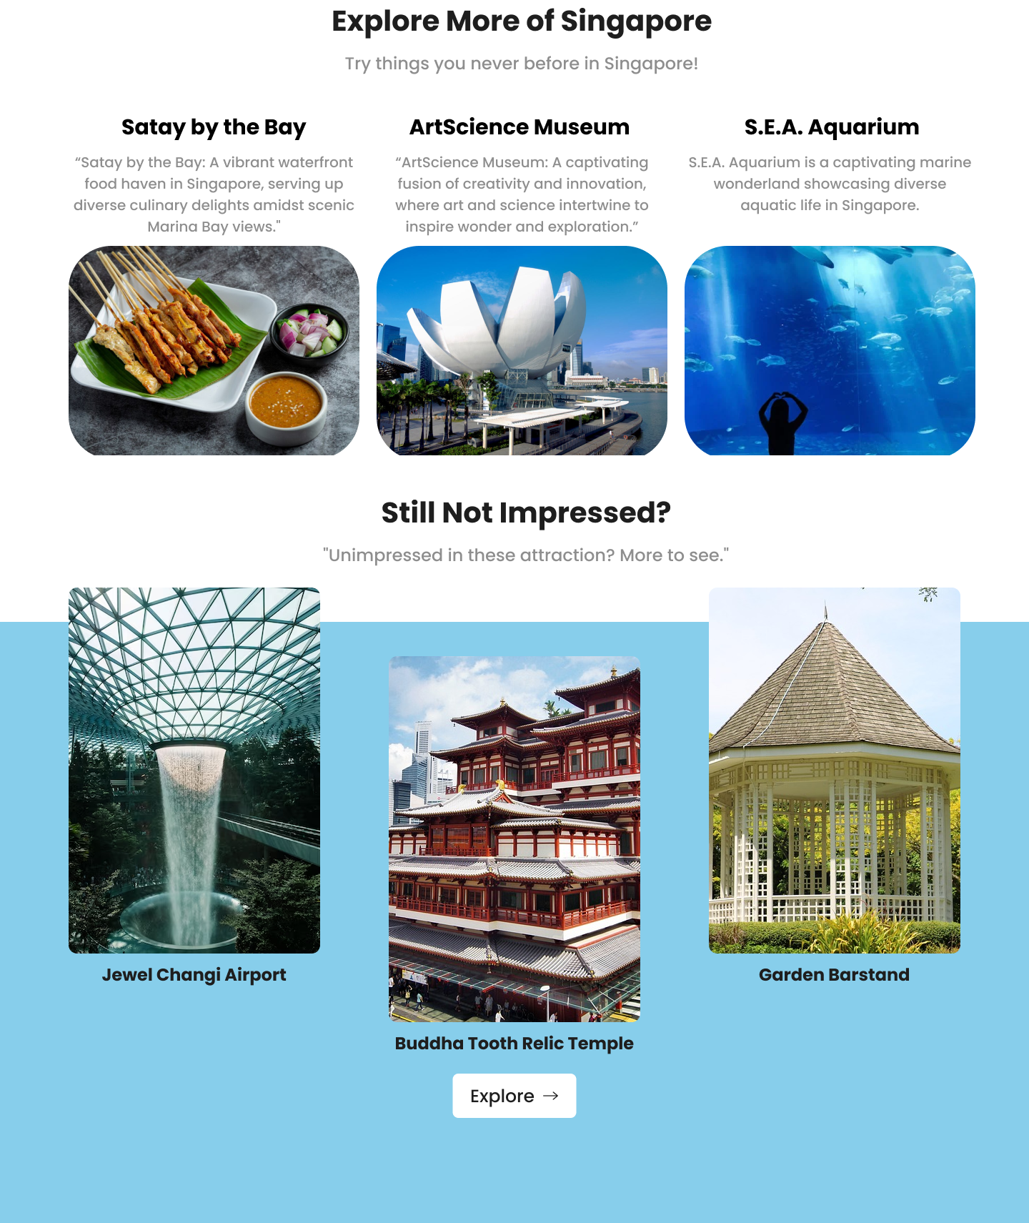
Organized Layout
Logical and sequential information presentation enables users to focus on one task at a time without distraction or diversion.

Slide 8
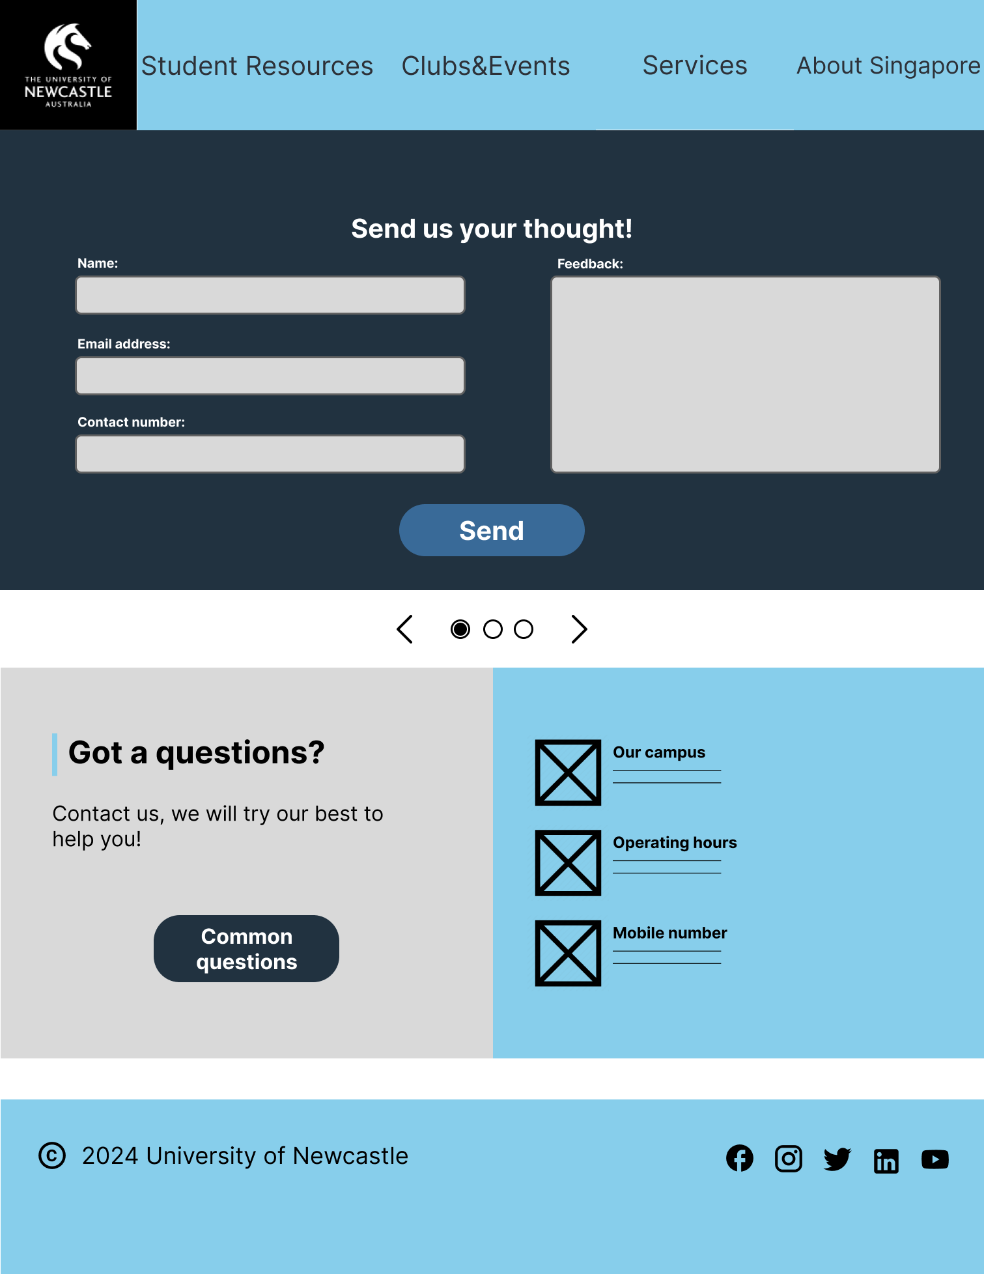
Feedback Mechanism
LearnLink incorporates feedback mechanisms like suggestion boxes or surveys, empowering users to share their thoughts and suggestions for future improvements to the website.

Slide 9
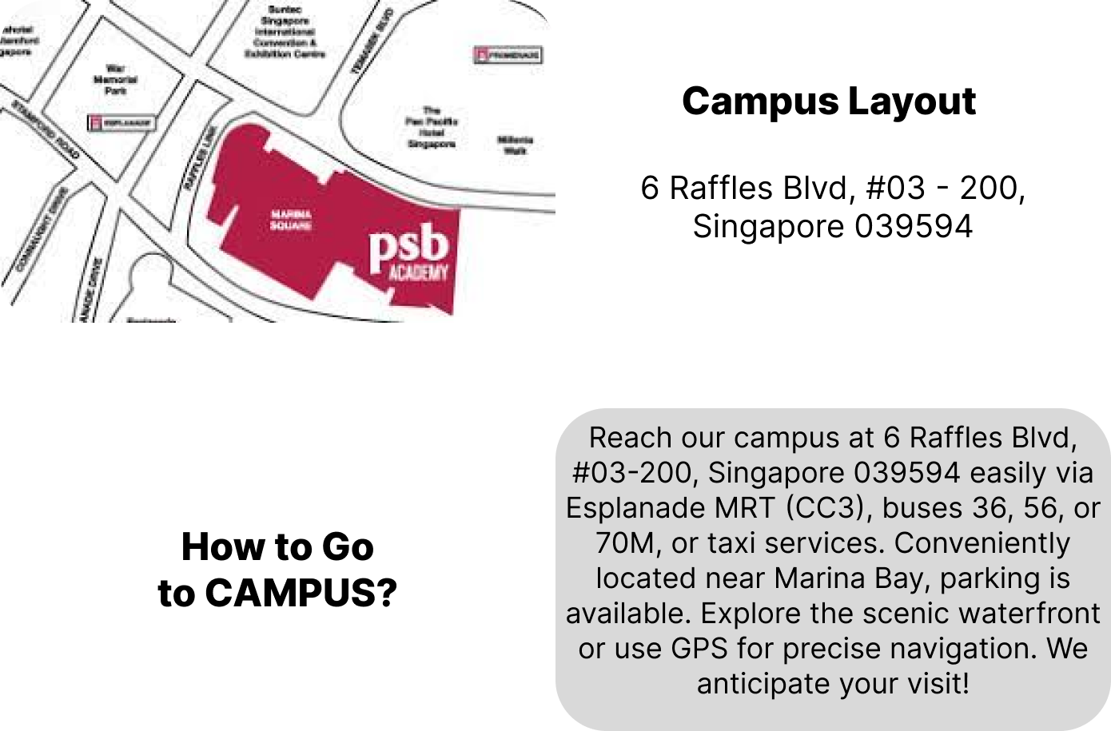

Addressing Freshman Needs
LearnLink Website
Student Resources
Clubs & Events
Services
About Singapore
Understanding the Transition
Highlight the significant transition that freshmen experience when entering university life, including the challenges and uncertainties they may face.
Notes:
2

Slide 10



LearnLink Website
Student Resources
Clubs & Events
Services
About Singapore
Emotional Support
Emphasize the importance of providing emotional support to freshmen, who may feel overwhelmed during their transition.
Notes:
by offering resources such as FAQs for both international and local students..

Slide 11
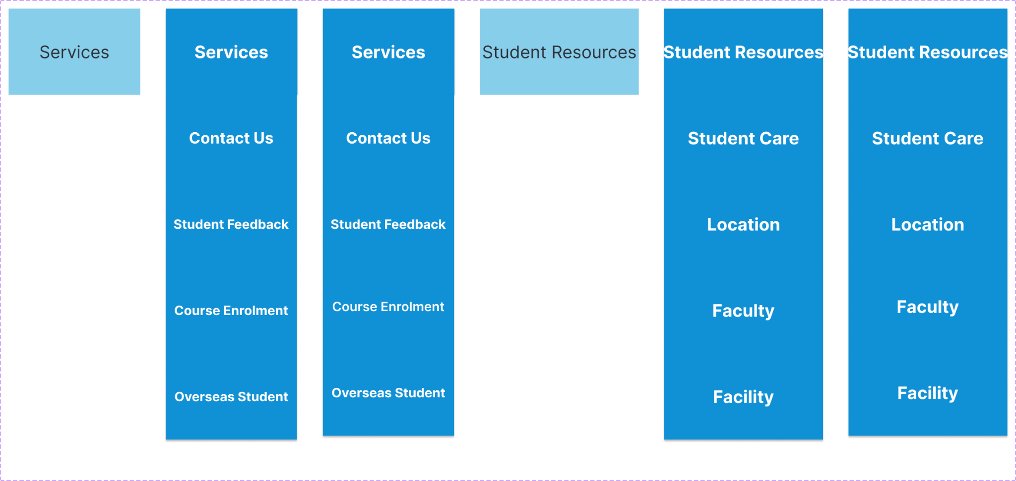

LearnLink Website
Student Resources
Clubs & Events
Services
About Singapore
Information Accessibility
Stress the importance of making essential information easily accessible to freshmen to empower them to make informed decisions.
Notes:
such as campus resources, student services & support, and uni contact information and feel confident in their new environment.

Slide 12
DEVELOPMENT PROCESS
Semi-Flexible Methodology
LearnLink Website
Student Resources
Clubs & Events
Services
About Singapore
In our project, we employ a mixed methodology approach that blends elements of traditional and agile methodologies
Mixed methodology approach blends traditional and agile methodologies.
Utilizes semi-flexible methodology allowing team members to choose tasks based on expertise and interest.
Semi-Flexible Process
1) Team Familiarization and Skill Assessment
2) Task Identification and Prioritization
3) Task Selection and Allocation
4) Continuous Monitoring and Adaptation
5) Review and Reflection
Notes:
3 Encourages engagement among team members. Optimizes project management processes for efficiency and adaptability. Tailored to the unique needs and dynamics of the team and project.

Slide 13
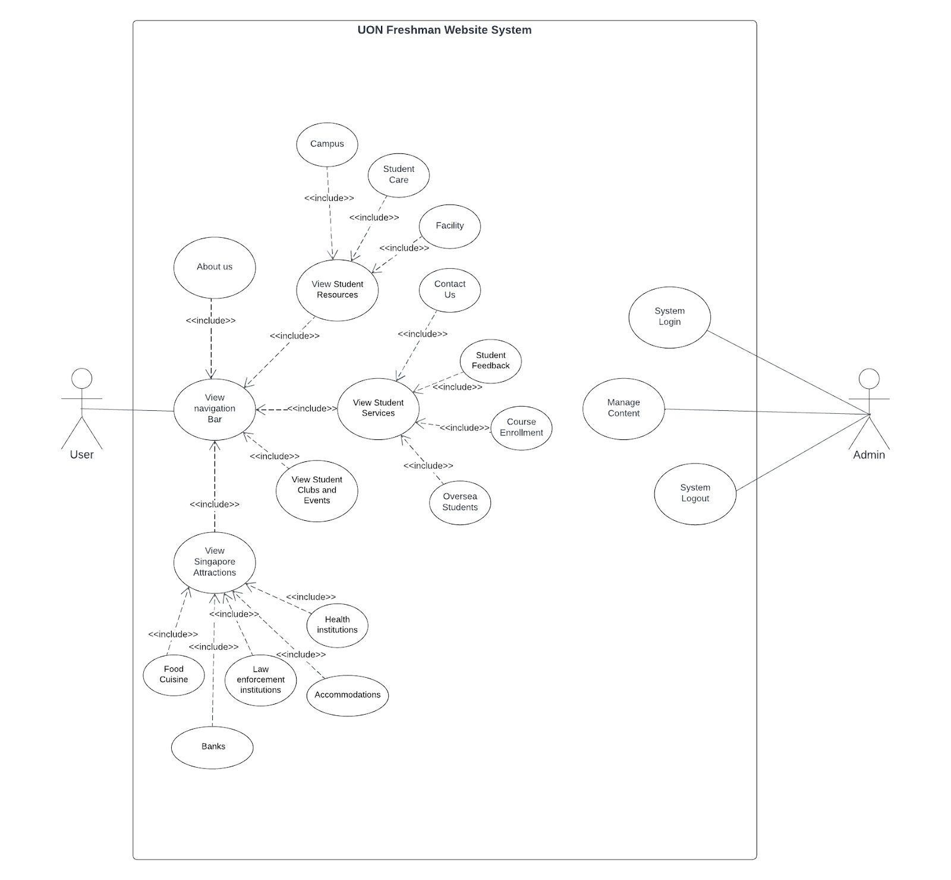
Use Case Diagram
LearnLink Website
Student Resources
Clubs & Events
Services
About Singapore

Slide 14
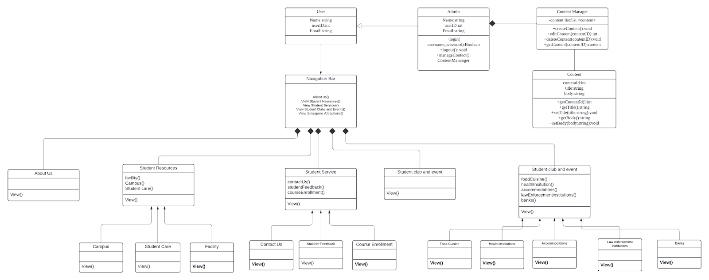
Class Diagram
Student Resources
Clubs & Events
Services
About Singapore

Slide 15
KEY FEATURES OF THE WEBSITE
LearnLink Website
Student Resources
Clubs & Events
Services
About Singapore
To-Do List
Health Institutions
Getting To Know Singapore

Slide 16
LearnLink Website
Student Resources
Clubs & Events
Services
About Singapore
Student Feedback
Contact Us
Services

Slide 17
Collaboration and Commitment
Team Dynamics
Commitment to Excellence
Agile Approach
LearnLink Website
Student Resources
Clubs & Events
Services
About Singapore
Diverse skills and teamwork were key in overcoming challenges.
Our team's commitment to excellence in all project phases. (idea, design, testing)
Highlight agile methods like Scrum collaborative development.

Slide 18
Problem-Solving and Resilience
LearnLink Website
Student Resources
Clubs & Events
Services
About Singapore
The team addressed obstacles and setbacks, showcasing resilience and problem-solving skills to maintain progress towards project goals.

Slide 19
Transparent Communication
LearnLink Website
Student Resources
Clubs & Events
Services
About Singapore
Emphasize transparent communication within the team, facilitated by regular meetings, updates, and open channels, enabling effective collaboration and idea sharing.

Slide 20
Flexibility and Adaptability
LearnLink Website
Student Resources
Clubs & Events
Services
About Singapore
Our team's adaptability to changing circumstances and requirements, highlighting flexibility in response to challenges, fostering resilience and overcoming obstacles.

Slide 21
Demonstration

Slide 22
THANKS!
Do you have any questions?
learnlinkfreshmen@gmail.com

